Slide 1
IKCU\Mechatronics Engineering\MEE303 Sensor Systems
W04
Sinusoidal Steady State
Sinusoidal Source Term and Systems Approach

Slide 2
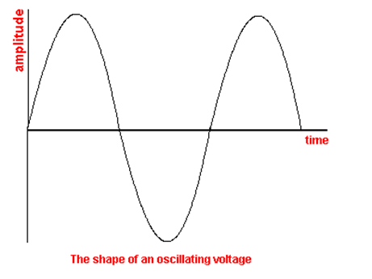
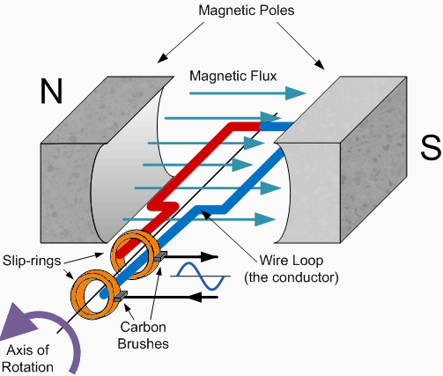
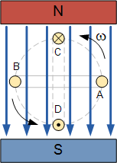
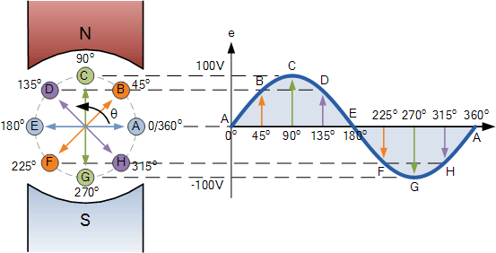
Sinusoidal Input
Alternating Voltage or Current
A DC voltage or current has a fixed magnitude (amplitude) and a definite direction associated with it. For example, +12V represents 12 volts in the positive direction, or -5V represents 5 volts in the negative direction.
An alternating function or AC Waveform on the other hand is a"Bi-directional" waveform.
An AC waveform is
constantly changing its polarity every half cycle
alternating between a positive maximum value and a negative maximum value
respectively with regards to time
Why it is an Alternating
The periodic or AC waveform is a result of the rotating electrical generator.
IKCU\Mechatronics Engineering\MEE212 Electric Circuits Dr.Levent ÇETİN

Slide 3
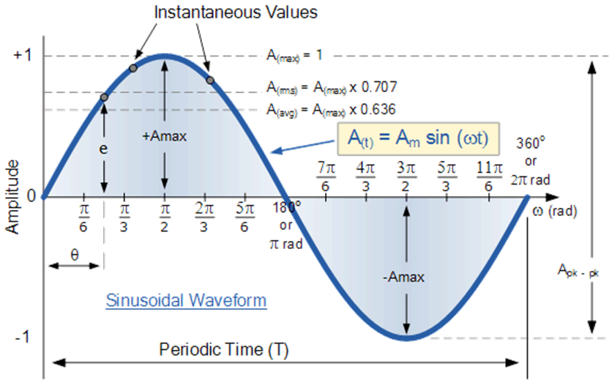
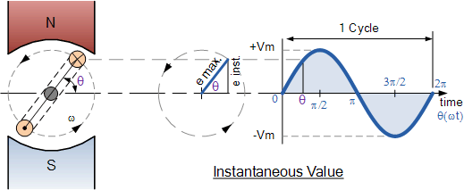
Sinusoidal Input
AC Waveform Charteristics
V_{avg} : (Full Rectified) Average Voltage, average value of the signal assuming that both of the peaks are positive sided. [V]
Average Value Calculation
Amplitude (A)=V_{max} [V]
RMS Value Calculation
V_{rms} : Effective Value of the signal [V]
Instantaneous Voltage : Terminal voltage at any time instant t after any zero crossing. To estimate the voltage value, the t ime instant should be converted to angle. It can be done using angular frequency (or rotating speed of rotor).
f: Frequency or oscillation of a signal is the value of repetition observed in a changing signal in unit time (per second) [Hz]
IKCU\Mechatronics Engineering\MEE212 Electric Circuits Dr.Levent ÇETİN

Slide 4
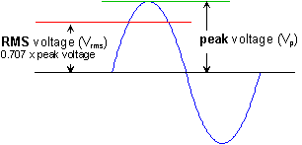
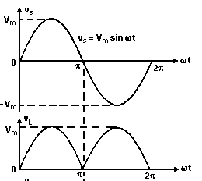
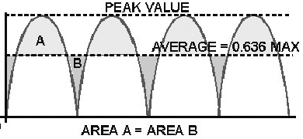
Sinusoidal Input
AC Waveform Charteristics
RMS Value Calculation
The value of an AC voltage is continually changing from zero up to the positive peak, through zero to the negative peak and back to zero again. Clearly for most of the time it is less than the peak voltage, so this is not a good measure of its real effect
The RMS value is the effective value of a varying voltage or current. It is the equivalent steady DC (constant) value which gives the same effect.
Average Value Calculation
The average of a symmetric alternating value is zero.
Thus one way to determine a quantitative measurement size is to use the average rectified value which can be computed by averaging the absolute value of a waveform over one full period of the waveform
IKCU\Mechatronics Engineering\MEE212 Electric Circuits Dr.Levent ÇETİN

Slide 5
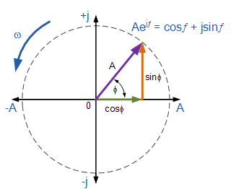
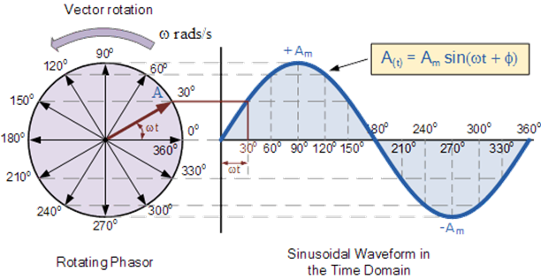

Sinusoidal Input
Euler Formula
establishes the fundamental relationship between the trigonometric functions and the complex exponential function
Phasor
A phasor is a complex number representing a sinusoidal function whose amplitude, angular frequency, and initial phase are time-invariant.
The projection of a rotating vector around origin y axis in cartesian coordinate system is a sine function so it can represent a sinusoidal (alternating) source (voltage or curent)
The length (or the radius) of the rotating vector is the amplitude of alternating voltage/current
The angle between the vector and the horizantal axis is the phase value (θ).
The angular velocity of this rotating vector is the angular frequency of alternating voltage/current.
The Sinusoidal Waveform of AC Network of Turkey
IKCU\Mechatronics Engineering\MEE212 Electric Circuits Dr.Levent ÇETİN

Slide 6
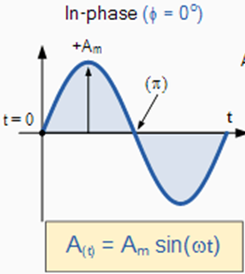
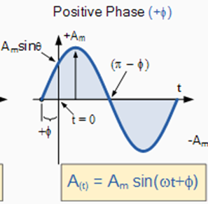
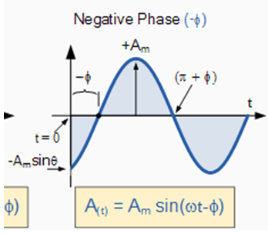
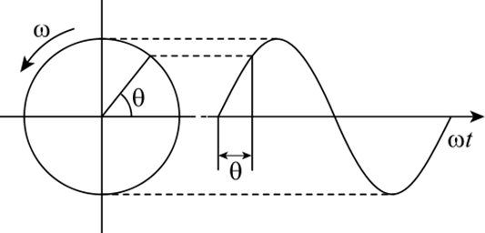
Sinusoidal Input
Phase
Phase is defined a particular stage or state of a periodic phenomenon. If this particular taken as a begining then three phase alternatives can exist
The phase of a Sinusoidal Waveform is the angle Φ (Greek letter Phi), in degrees or radians that the waveform has shifted from a certain reference point along the horizontal zero axis.
The phase is caluclated by
first the lead or lag time of signal to reach zero magnitude with positive derivative value (with trend of increase)
And after calculating the phase angle using mesaured time.
IKCU\Mechatronics Engineering\MEE212 Electric Circuits Dr.Levent ÇETİN

Slide 7
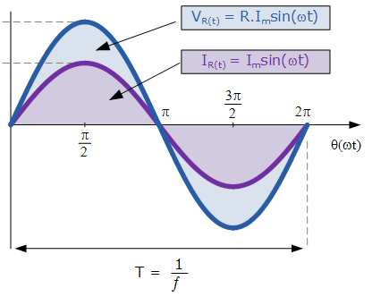
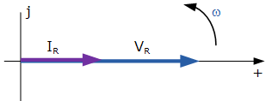
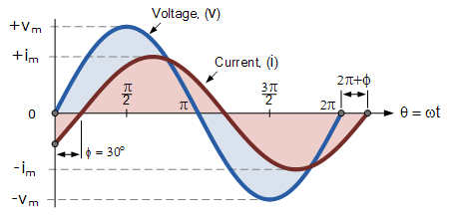
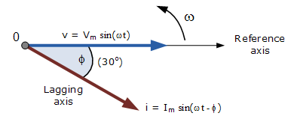
Sinusoidal Input
Comparing two atlernating circuit variables
Comparing amplitudes
Phasors are useful
Comparing phases
Phasors are useful
IKCU\Mechatronics Engineering\MEE212 Electric Circuits Dr.Levent ÇETİN

Slide 8
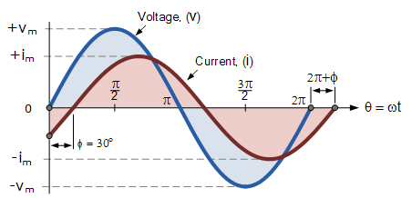
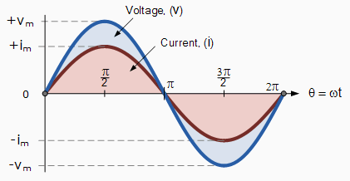
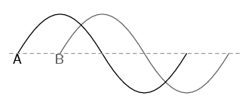
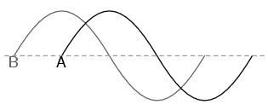
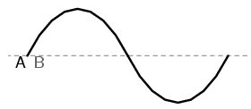
Sinusoidal Input
Comparing two atlernating circuit variables
An important point in operations of two time dependent signals is whether they are synchronized or not.
For electrical definitions, two voltage signals or two corrent signals or one voltage with one current signals either can be synchronized or have a phase diference.
If two signals are synchronized, they both pass the zero points and the maximum value points at the same time.
If two signals pass the zero points and maximum value points in different moments then a phase shift occurs.
Phase shift is zero . Therefore, two signals are in phase
Phase shift is 90° when the reference signal is B.
Phase shift is 90° when the reference signal is A.
Phase shift is -90° when the reference signal is B.
IKCU\Mechatronics Engineering\MEE212 Electric Circuits Dr.Levent ÇETİN

Slide 9
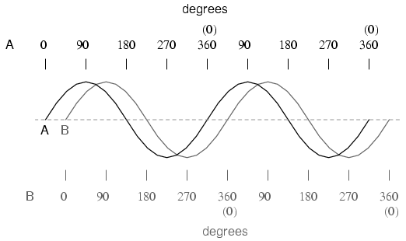
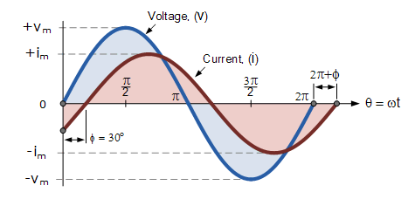
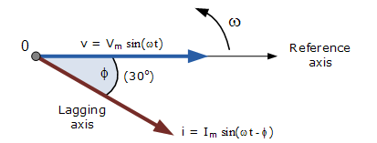
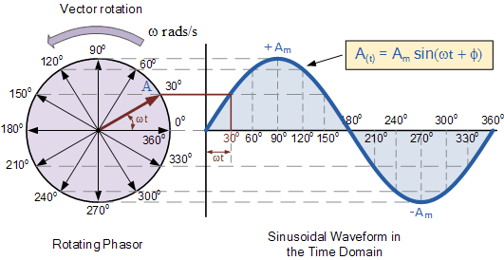
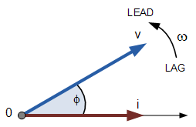
Sinusoidal Input
the voltage phasor leads the current phasor
Phase is 45° from B to A
the current phasor lags behind the voltage phasor
the waveforms are frozen at time t = 30º, the corresponding phasor diagram would look like the one shown on the right.
IKCU\Mechatronics Engineering\MEE212 Electric Circuits Dr.Levent ÇETİN

Slide 10
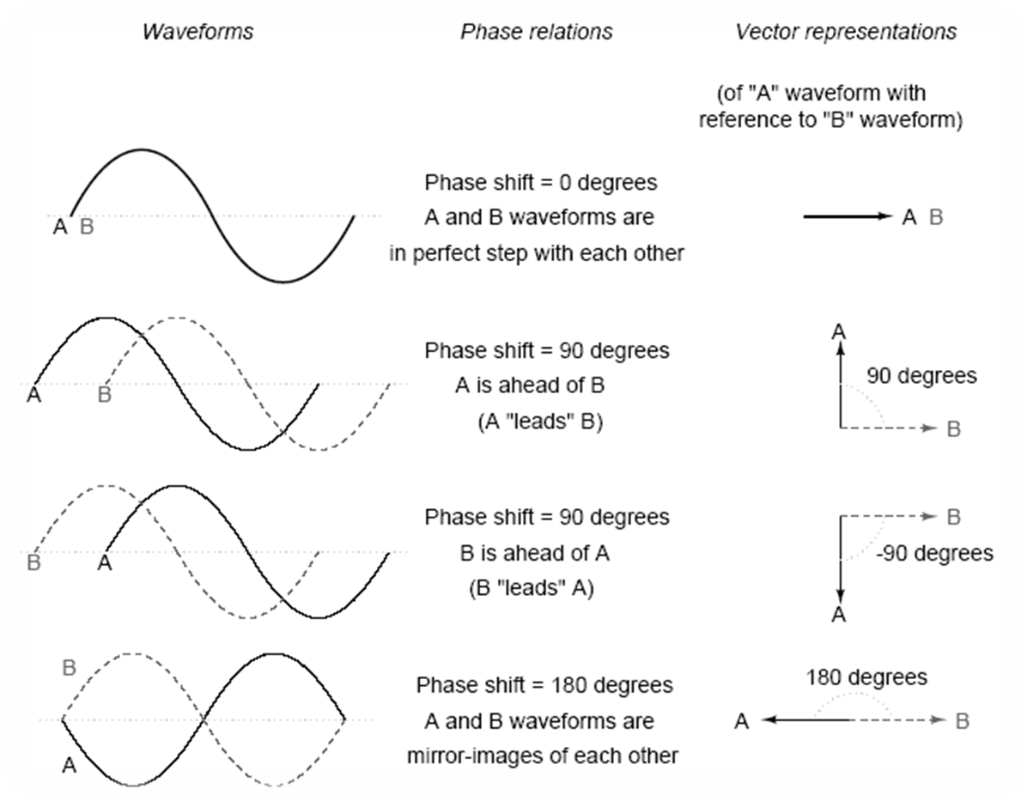
Sinusoidal Input
IKCU\Mechatronics Engineering\MEE212 Electric Circuits Dr.Levent ÇETİN

Slide 11
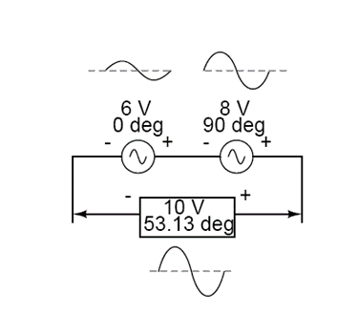
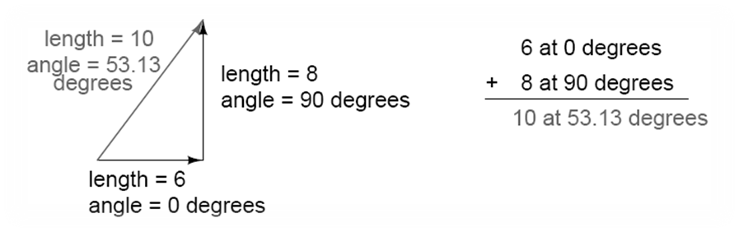
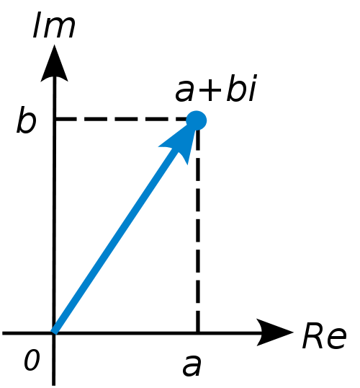
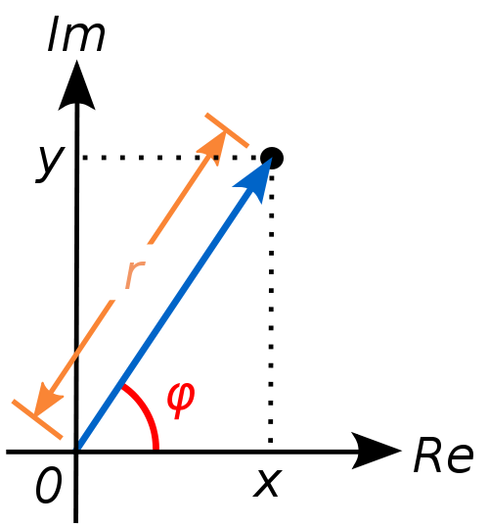
Sinusoidal Input
Phasors as complex numbers
The voltage by a combination of AC current/voltage sources connected to the same circuit is determined by vector addition and subtraction operations.
Two dimensional vectors can also be represented via complex numbers
IKCU\Mechatronics Engineering\MEE212 Electric Circuits Dr.Levent ÇETİN

Slide 12
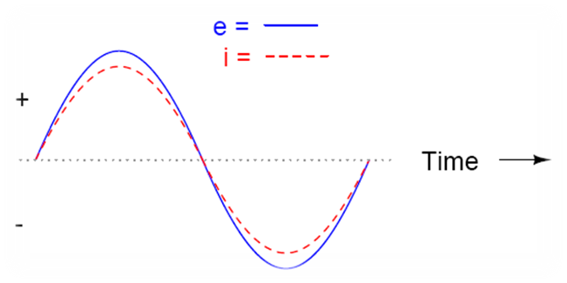
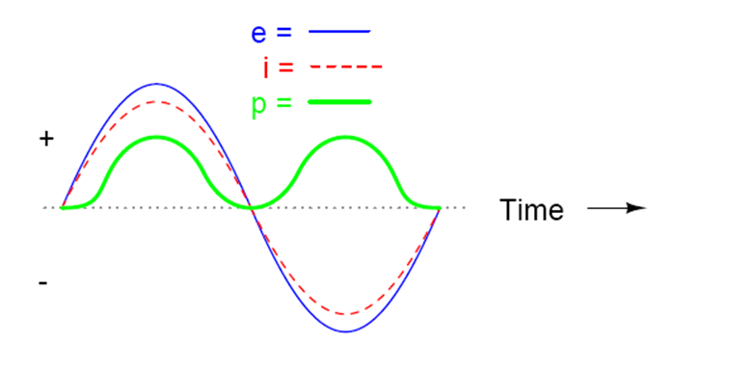
Passive Components reaction to Sinusoidal Input
Resistor (R)
Ohm’s Law can be used for resistance under the influence of alternating voltage.
Nevertheles, the amplitude changes due to Ohm’s Law.
According to equations above, there is no phase shift between current and voltage on a resistor.
AC power dissipated on resistor is:
IKCU\Mechatronics Engineering\MEE212 Electric Circuits Dr.Levent ÇETİN

Slide 13
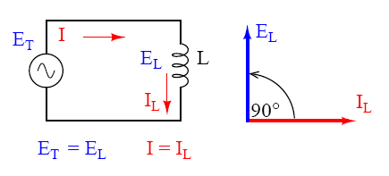
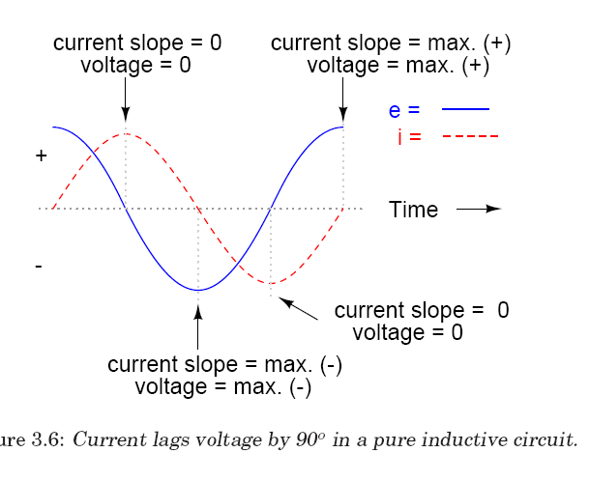
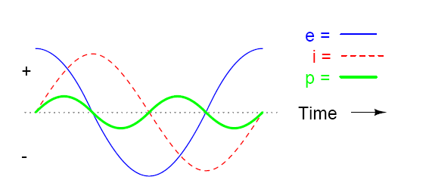
Passive Components reaction to Sinusoidal Input
İnductor (Coil)
In contrast with resistors, coils under alternating voltage resists against alternating current. The voltage on a coil (the voltage measured between two terminals) can be calculated using Lenz Law.
If this equation is studied considering the alternating current, the relationship between the current and voltage might be predicted
The phase shift results with negative electrical power. Negative power denotes that the coil transfer power to the circuit.
The ‘resistance’ of coils changes due to frequency. This is called as reactance (inductive reactance X_{L}) for this reason.
This result shows us that there is a 90 degrees of phase shift between voltage and current on a coil under AC. The voltage leads current by phase angle of 90 degree
IKCU\Mechatronics Engineering\MEE212 Electric Circuits Dr.Levent ÇETİN

Slide 14
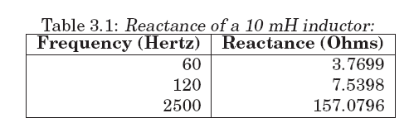
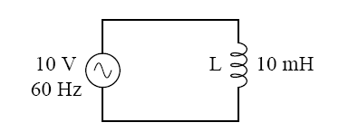
Passive Components reaction to Sinusoidal Input Examples
Inductive Reactance
The ‘resistance’ of coils changes due to frequency. This is called as reactance (inductive reactance XL) for this reason.
Ohm’s Law might be implemented easily to alternating current circuits using quantity, the reactance. In that case, the calculations should be made using complex numbers instead of scalars.
IKCU\Mechatronics Engineering\MEE212 Electric Circuits Dr.Levent ÇETİN

Slide 15
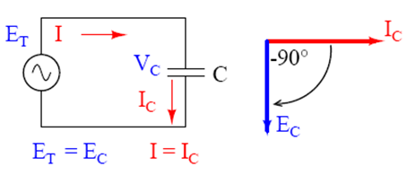
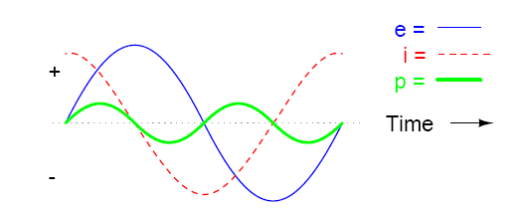
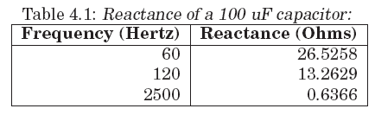
Passive Components reaction to Sinusoidal Input
Capacitor (C) (Capacitance)
Capacitors react different due to the voltage level applied to them under alternating current.
If the voltage level applied is greater than the voltage on a capacitor, the source charges the capacitor; in opposite case, capacitor behaves like a source. And discharges through the circuit elements.
The current equation for a capacitor is:
The phase difference between voltage and current is 90 degrees on a capacitor or in other words, current leads voltage 90 degrees.
This case results with negative electrical power which means that capacitor transfers power to the circuit (i.e. Capacitor discharges its electrical charge).
The ‘resistance’ of the capacitors change due to the frequency of the alternating voltage.The higher frequency of the AC signal, the more easily that signal will pass through the capacitor. Thus, this is called as capacitive reactance, X_{c}.
IKCU\Mechatronics Engineering\MEE212 Electric Circuits Dr.Levent ÇETİN

Slide 16
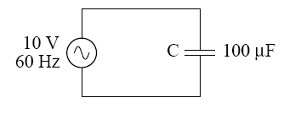
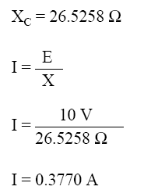
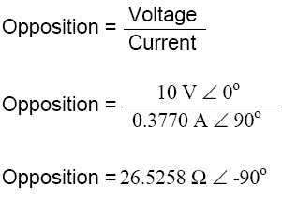
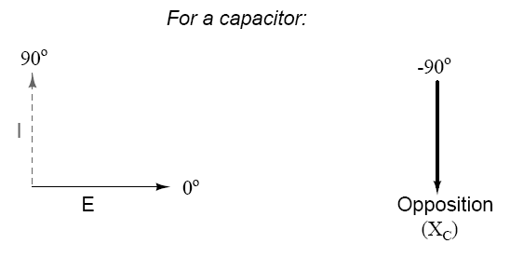
Sinusoidal Input
Capacitor (C) (Capacitance)
The current of the AC source leads the voltage of the source 90 degrees. The resistance effect of the capacitor to AC source is calculated considering this.
IKCU\Mechatronics Engineering\MEE212 Electric Circuits Dr.Levent ÇETİN

Slide 17
Sinusoidal Input
Resistor, Reactance and Impedance
The resistance against the current can be in three types:
Resistance: It is the friction of electrons during motion. Its symbol is “R” and unit is [Ω] (i.e. [Ohm]). It does not form any phase shift.
Reactance: It is the inertia of electrons. It occurs if there is a change in voltage or current values (if an electric or magnetic field occurs). The capacitor and inductor are the main circuit components which this influence is highly distinct.
If there is a reactance effect in a circuit, there is also phase shift. If the component is a capacitor, the current leads voltage by 90 degrees whereas if it is an inductance, the current lags voltage by 90 degrees.
Impedance, is the strain against the current in an electrical circuit. Impedance is the total resistance and reactance effects of all components. The resistance in DC circuits is the impedance in AC’s
Ohm’s Law via Impedance
The AC implemented Ohm’s Law can be seen as below. Please consider that all the quantities are in complex number form in the equation below :
Like Ohm’s Law, other laws (Kirrschoff’s, grid theorems, etc.) used in circuit analysis can be also implemented in AC in condition of using complex numbers.
IKCU\Mechatronics Engineering\MEE212 Electric Circuits Dr.Levent ÇETİN

Slide 18
AC Circuit Analysis
1. Frequency Transfer Function Method
Find the transfer function
F(s)
G(s)
X(s)
Assuming all initial conditions are zero
Set s=jw and find F(jw) which is complex function
Convert Cartesian form to polar form using formulas
Find the steady state sinusoidal function with given formula
IKCU\Mechatronics Engineering\MEE212 Electric Circuits Dr.Levent ÇETİN

